Slide 1

PulseX - The Future of Heart Care and Health
Presented By:
Mr. Yassine Bazgour
Supervised By:
Dr. Mohammed Ameksa, Dr. Mohamed-Amine Chadi

Slide 2
Problematic
01

Slide 3
7,095,536
Number of Covid19 deaths worldwide ( 2019 - 2024 )
Source:
https://data.who.int/dashboards/covid19/deaths

Slide 4
20 500 000
Deaths Due Cardiovascular Diseases (CVD)
( 2021 )
Source:
https://world-heart-federation.org/news/deaths-from-cardiovascular-disease-surged-60-globally-over-the-last-30-years-report/#:~:text=GENEVA%2C%2020%20May%202023%20%E2%80%93%20Deaths%20from,occurring%20in%20low%2D%20and%20middle%2Dincome%20countries%20(LMICs).

Slide 5
640 000 000
people living with heart and circulatory diseases across the world
Source:
https://www.bhf.org.uk/-/media/files/for-professionals/research/heart-statistics/bhf-cvd-statistics-global-factsheet.pdf

Slide 6
38%
Of all deaths in Morocco due cardiovascular Disease
Source:
https://www.researchgate.net/publication/355082014_Epidemiology_of_Cardiovascular_Diseases_in_Morocco_A_Systematic_Review

Slide 7
Solution
02

Slide 8

Telemedicine System

Slide 9


What others have done so far ?
Stethoscopes Not Capable to Record or Process Sounds
Ai Models Without Hardware & Access from Users

Slide 10


What Must be Done!
Digitalization Of Heartbeat Analysis
Embed Ai into Hardware & User-Friendly System

Slide 11
System Architecture
03

Slide 12







Age
Gender
Region
Smoking State
Interface
Prediction
If Normal
Encode
Data
User
Binary
Classifier
Result
Heartbeat
Audio / ECG Signals
If Abnormal
Embedded
System
Multiclass
Classifier
Disease Type
ECG Monitoring

Slide 13
Data
04

Slide 14

Source:
https://github.com/sani002/BMD-HS-Dataset

Slide 15
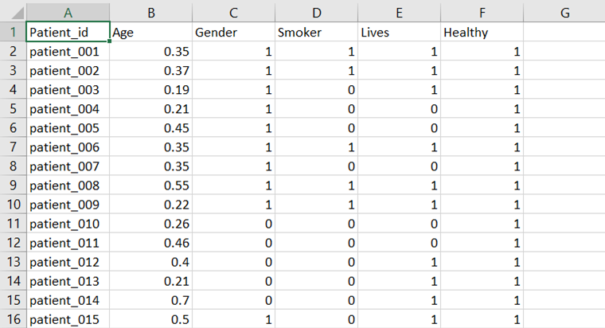
Chunk From metadata.csv

Slide 16
Diseases Types Description
AS: Aortic Stenosis
AR: Aortic Regurgitation
MS: Mitral Stenosis
MR: Mitral Regurgitation
MD: multi-disease patients
N: normal patients

Slide 17
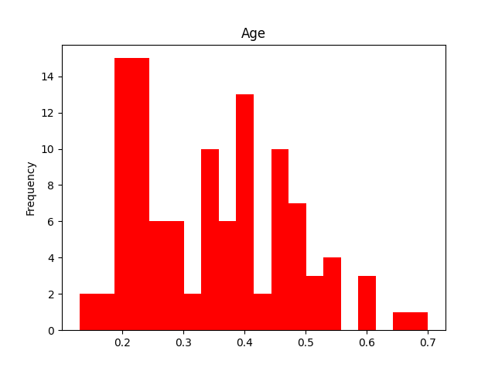
20
30
40
50
60
70

Slide 18
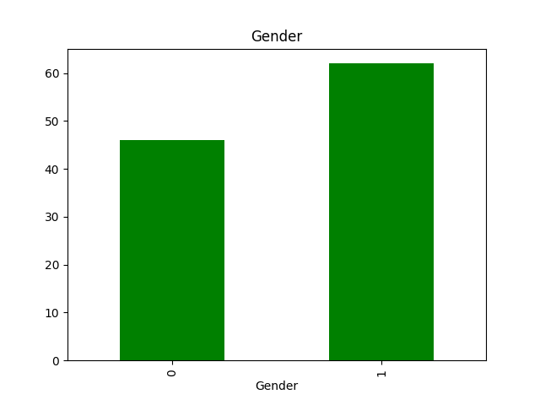
Female
Male

Slide 19
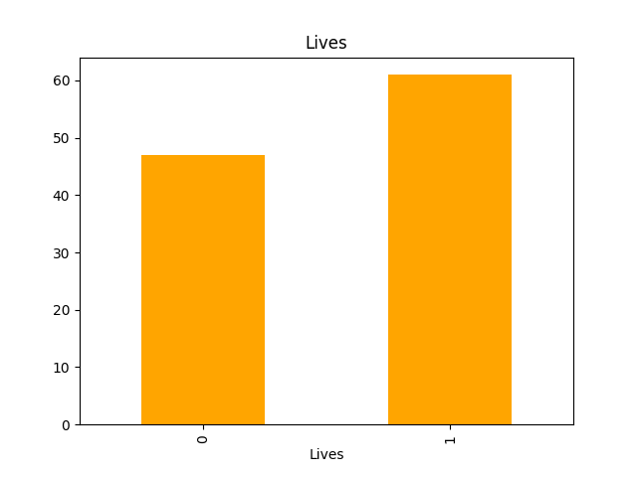
Rural
Urban

Slide 20
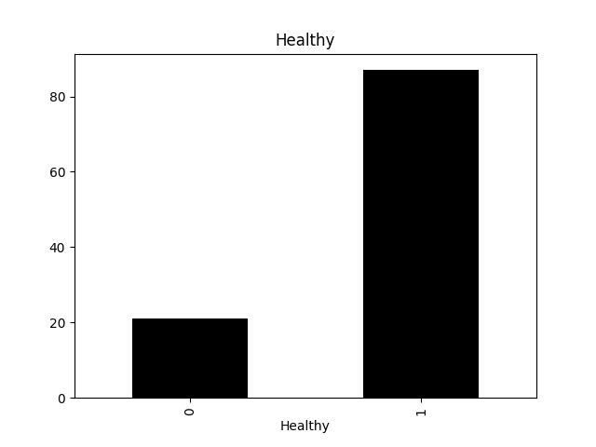
Healthy
Not Healthy

Slide 21
🔊 872 audios 🩺 6 diagnostic categories | 1 Normal | 5 Abnormal 🧑 Patient Metadata: age | gender | region | if they smoke or not ✅ Good-quality audios ⚖️ Class imbalance with Multi-Disease as majority class 📊 Widely used for heartbeats anomaly classification models

Slide 22


Data Preprocessing
Adding Guassian
Noise
Boosting Audios
Volume

Slide 23


Binary Classifier Data
Multi Classifier Data
Before: 6 Classes
Abnormal Classes: 704 Audios
Normal Class: 168 Audios
After: 2 Classes
Abnormal Class: 335 Audios
Normal Class: 336 Audios
Before: 6 Classes
Abnormal Classes: 704 Audios
Normal Class: 168 Audios
After: 5 Classes
ar: 336 Audios
as: 384 Audios
mr: 528 Audios
ms: 528 Audios
md: 2448 Audios

Slide 24
Model
05

Slide 25
ResNet-18
2021
https://onlinelibrary.wiley.com/doi/10.1155/2021/6649970
Accuracy: 96.5%
2022
https://journals.sagepub.com/doi/abs/10.3233/MGS-220317
Accuracy: 98.95%
2024
https://ieeexplore.ieee.org/abstract/document/10779717
Accuracy: 98.6%

Slide 26
ResNet-18
Input Size: 224 × 224 × 3 • Parameters: 11,689,512 • Size: 11,689,512 (parameters) × 4 (byte) = 46.75 MB • FLOPs: ~1.8B • Depth: 18 layers • Training Speed: Very fast due to simple residual blocks and shallow depth

Slide 27
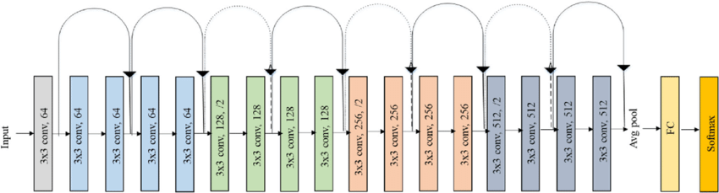
ResNet-18 Architecture
Source:
https://www.researchgate.net/publication/336642248_A_Deep_Learning_Approach_for_Automated_Diagnosis_and_Multi-Class_Classification_of_Alzheimer's_Disease_Stages_Using_Resting-State_fMRI_and_Residual_Neural_Networks

Slide 28
Prototype
06

Slide 29
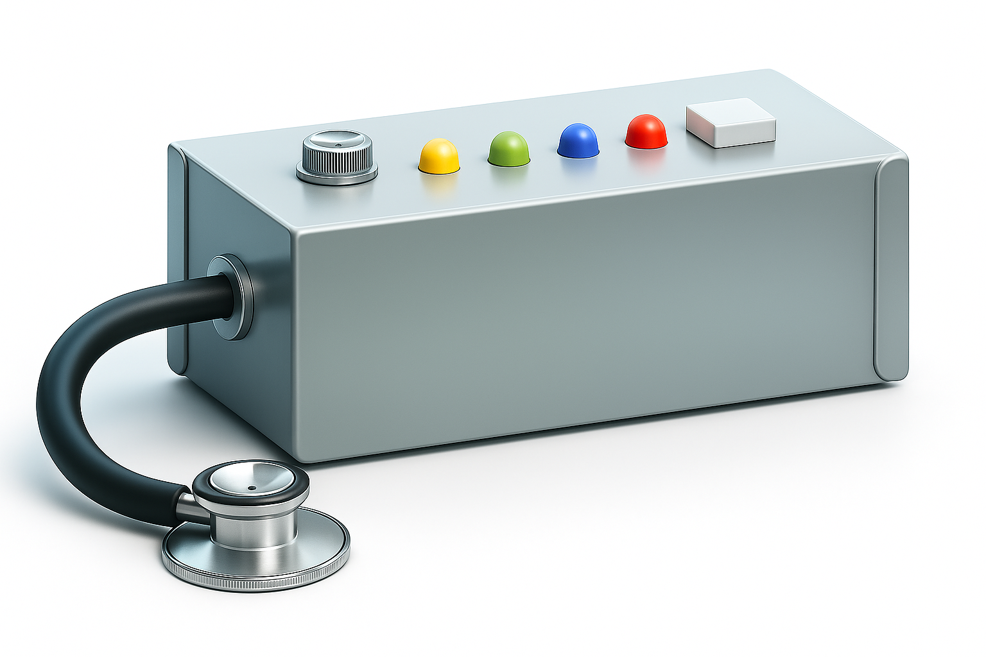

Slide 30
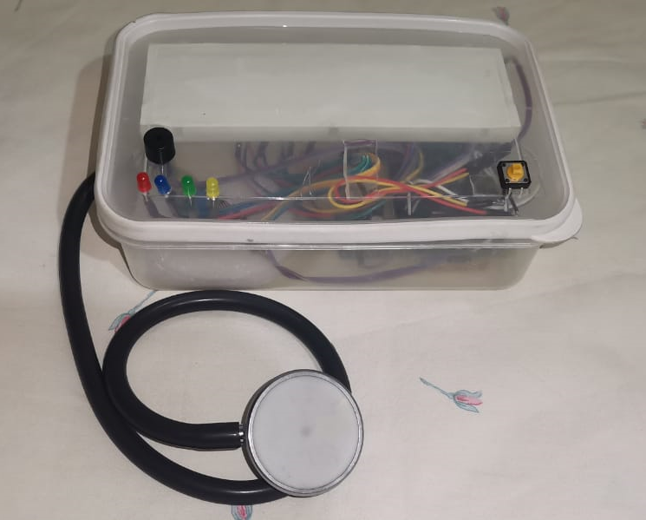

Slide 31
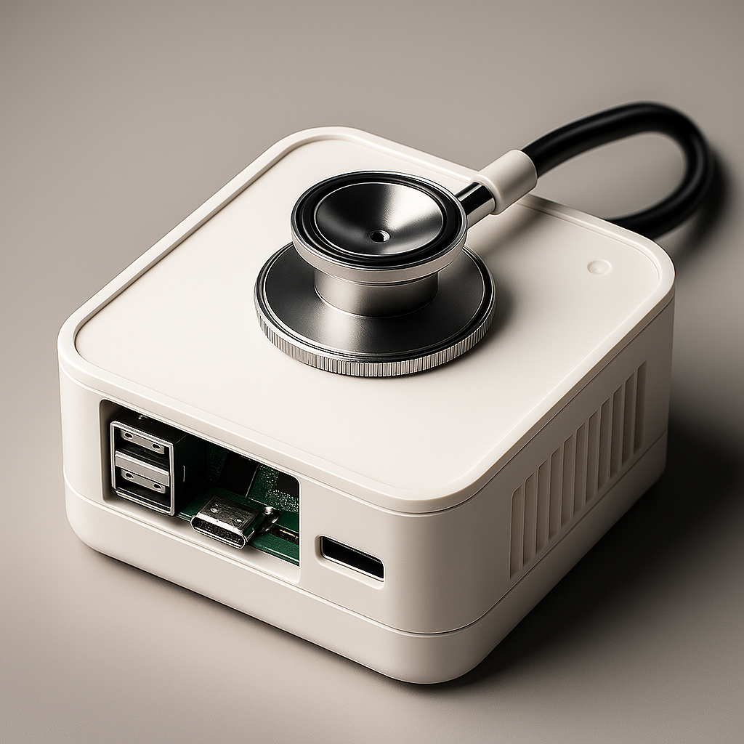

Slide 32
Interface
07

Slide 33




Technologies Used
HTML
Javascript
CSS
Python
Backend
Frontend

Slide 34
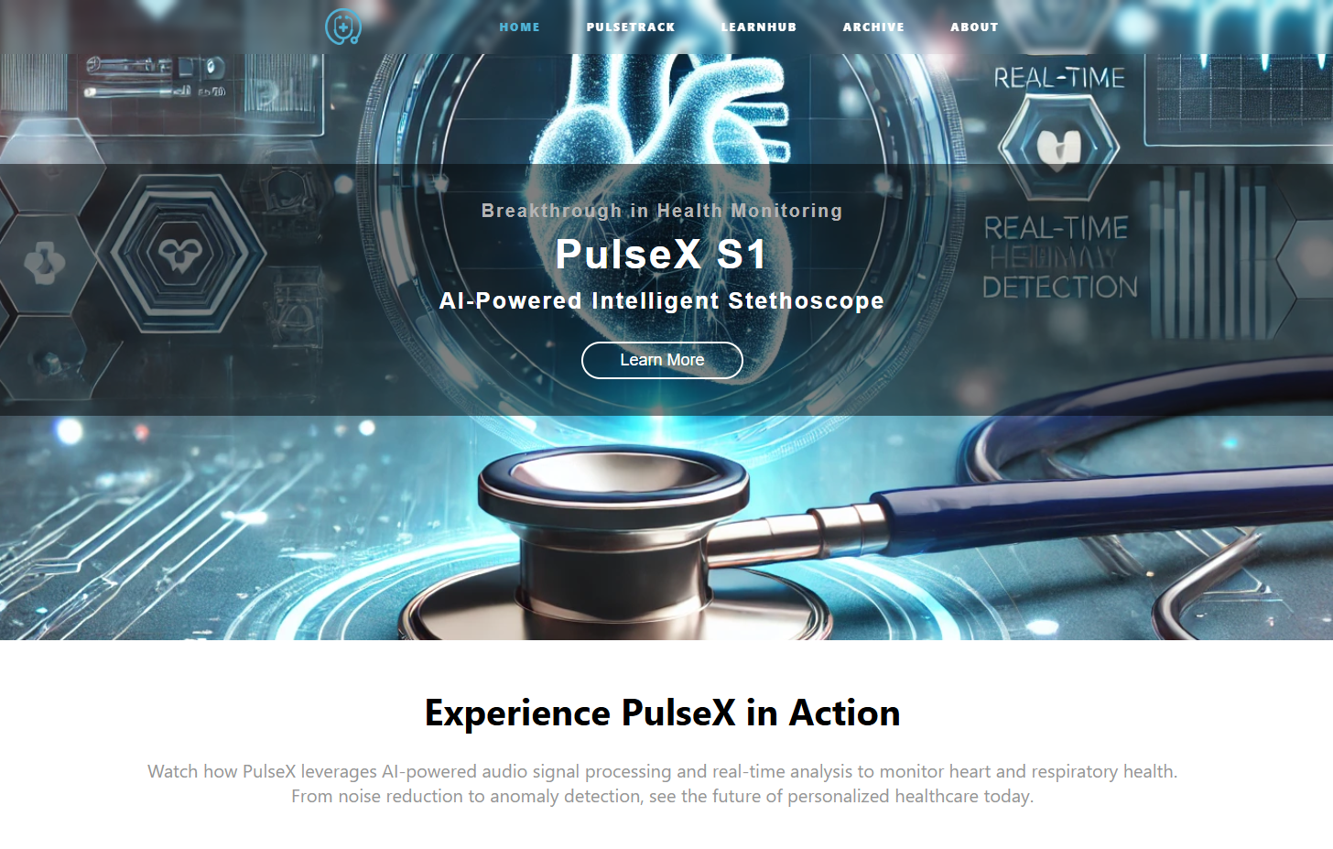

Slide 35
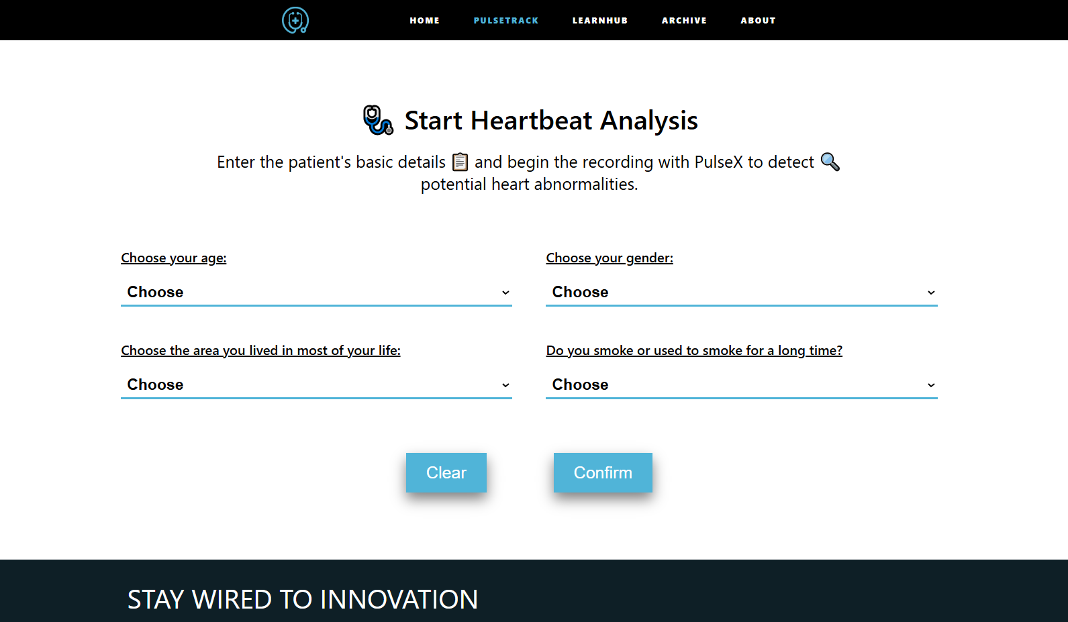

Slide 36
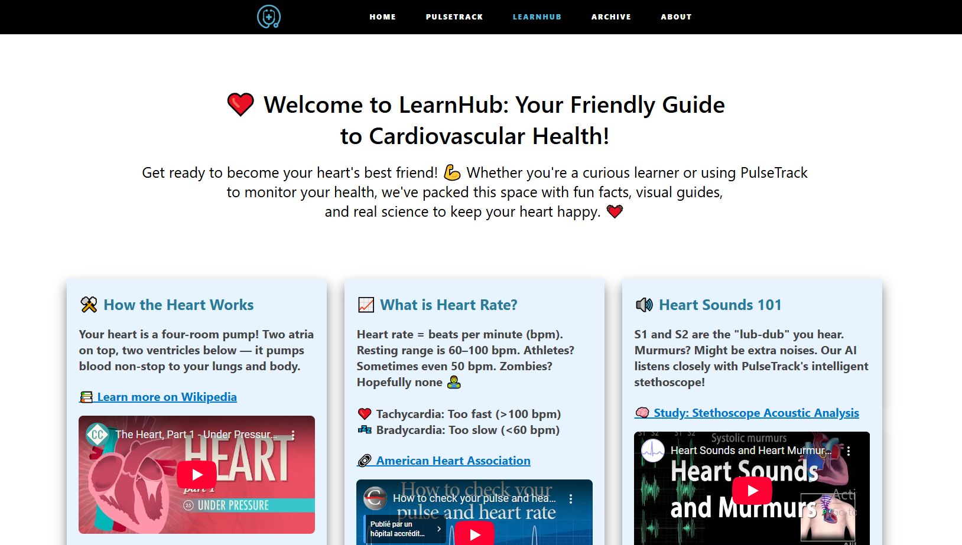

Slide 37
Results
08

Slide 38
Binary Classifier Metrics

Slide 39
Validation Accuracy: 92.65%
Precision: 89.19%
Recall: 97.06%
F1-score: 92.96%

Slide 40
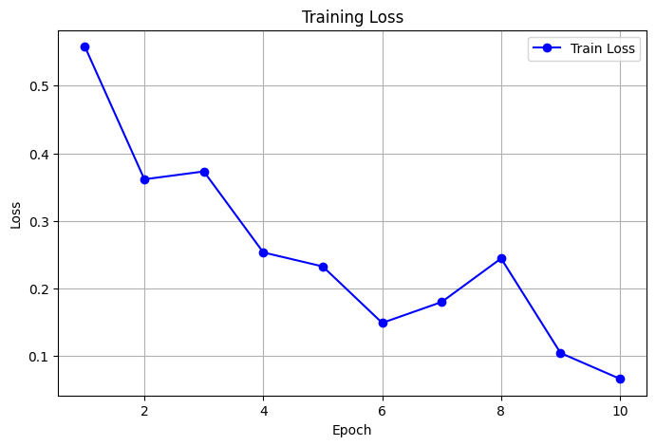

Slide 41
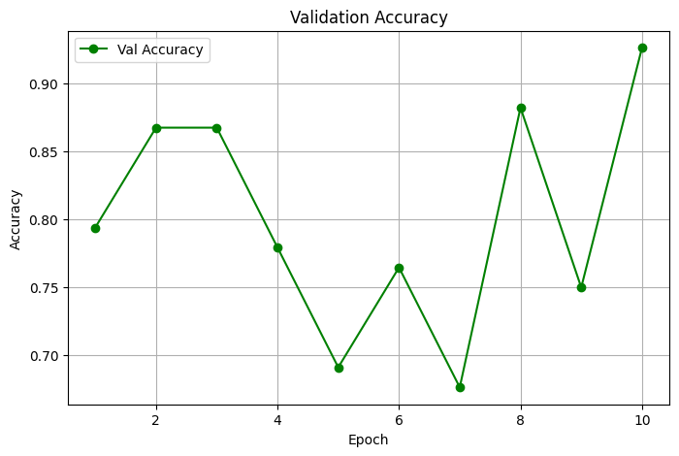

Slide 42
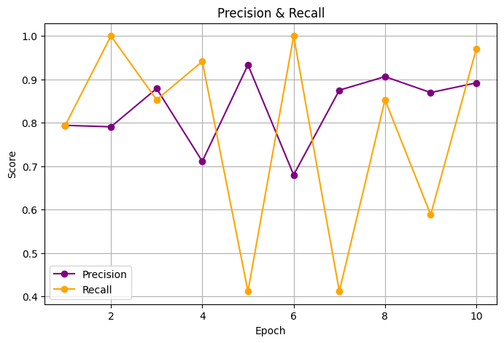

Slide 43
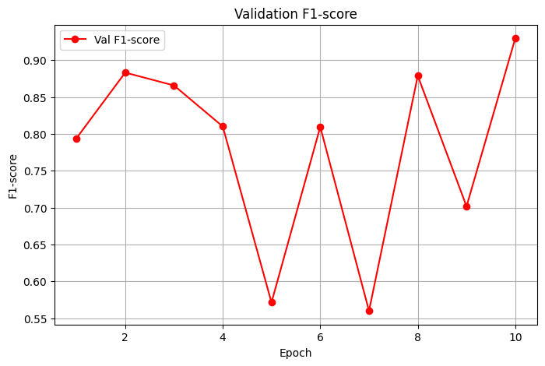

Slide 44
Multi Classifier Metrics

Slide 45
Validation Accuracy: 80.62%
Precision: 81.13%
Recall: 80.33%
F1-score: 77.57%

Slide 46
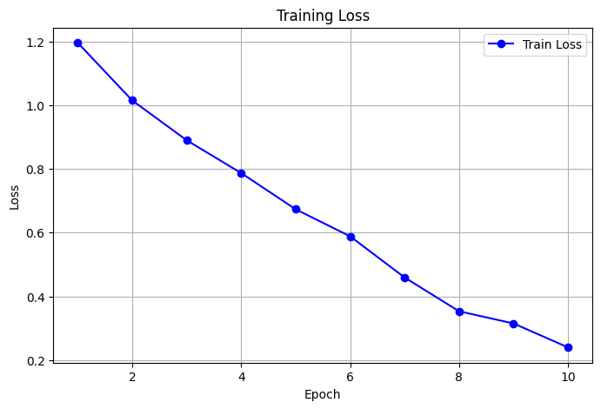

Slide 47
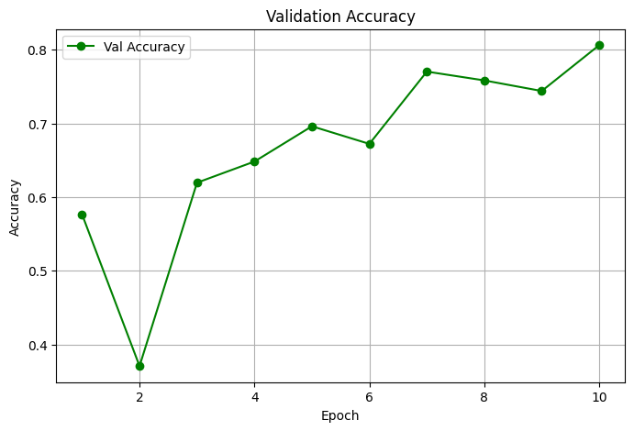

Slide 48
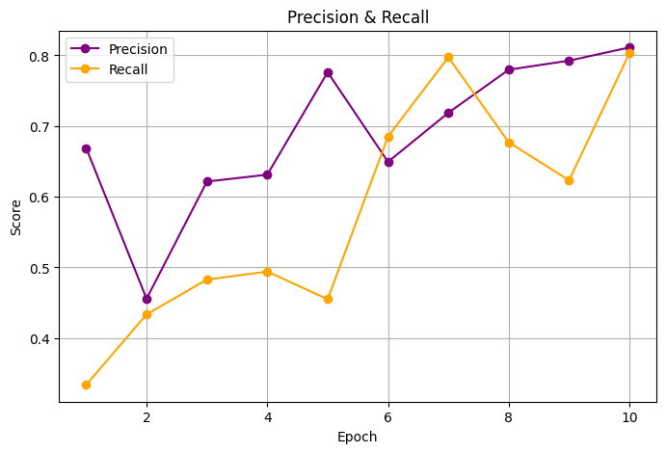

Slide 49
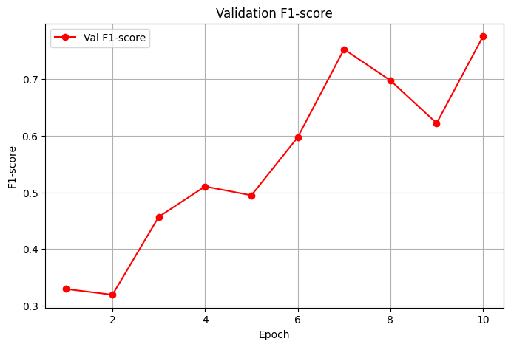

Slide 50
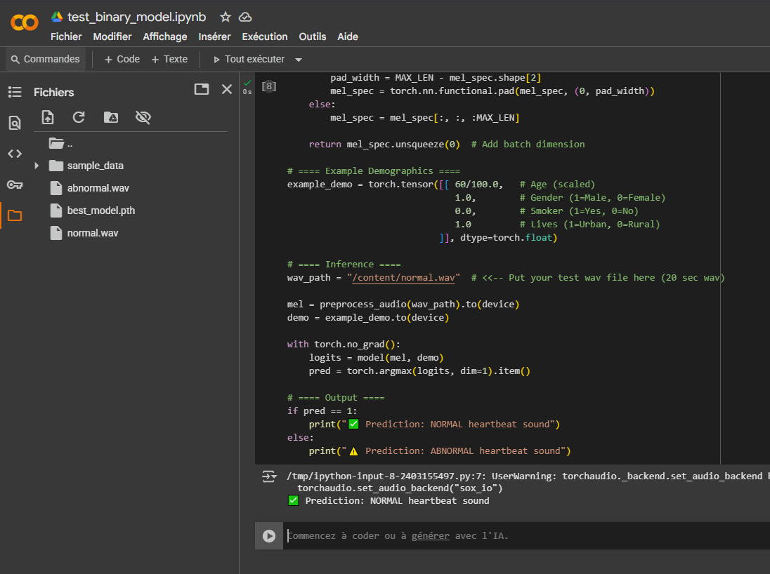

Slide 51
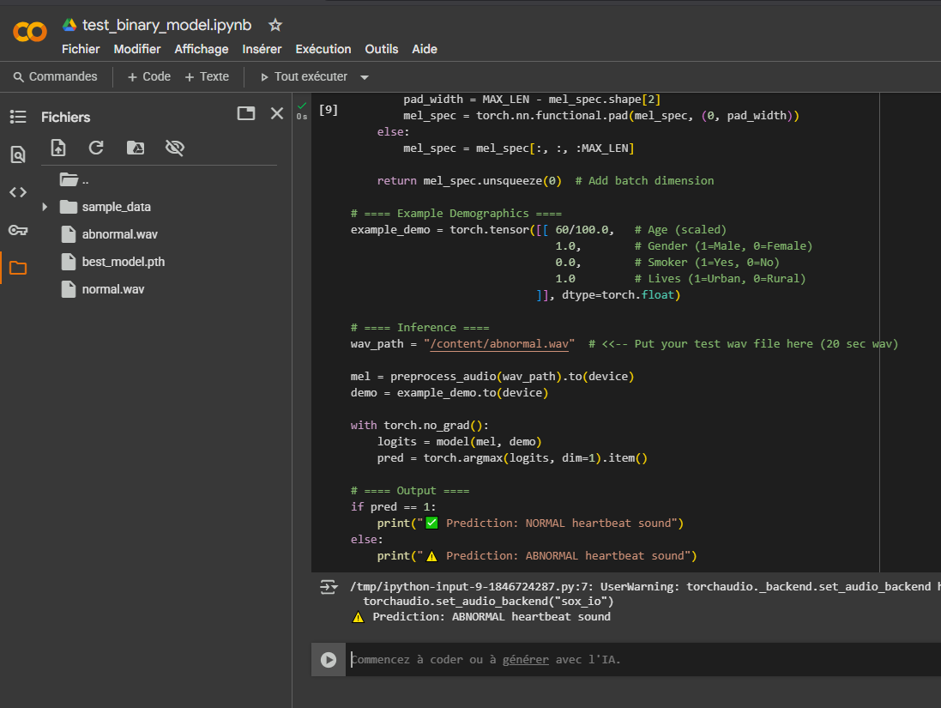

Slide 52
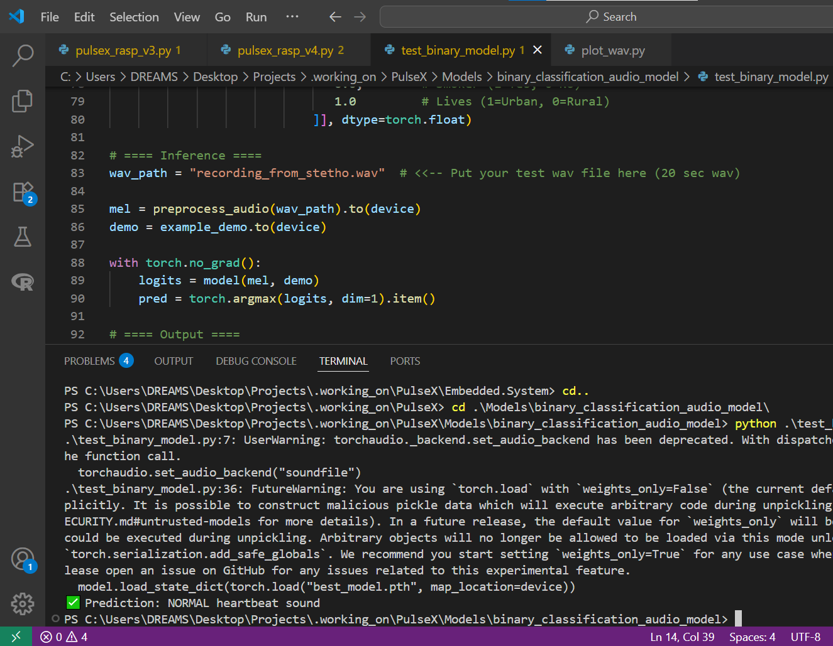

Slide 53
Demo
09

Slide 54
Discussion
10

Slide 55



Benefits
Early Detection of Cardiovascular Issues
Low-Cost, High-Quality Acoustic Analysis
Real-Time Monitoring & AI Insights

Slide 56


Limitations
Low-Quality Hardware
Low-Quality and Noisy Data

Slide 57
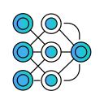


Future Work
Test Other Pretrained Models
Integrate Clinical-Grade Sensors
Enlarge Dataset and Improve its Quality

Slide 58
Price?

Slide 59
2000dh
Core components = 1547dh
Trained models + interface = 453dh

Slide 60
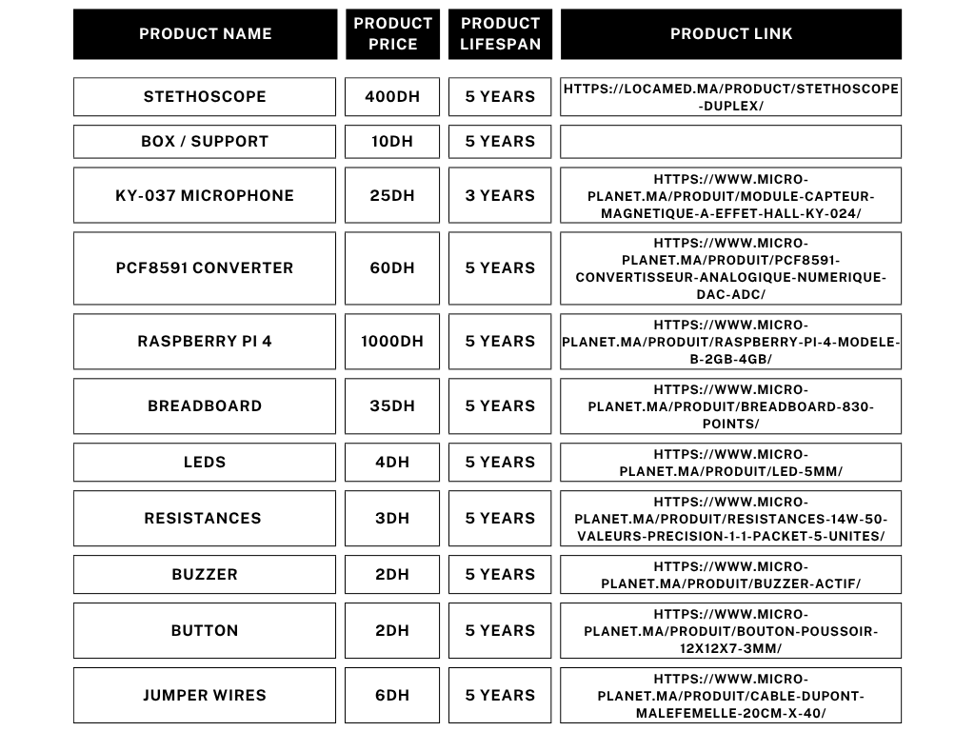

Slide 61
